Slide 1
OPTIMIZING AVIATION INSIGHTS A Data Engineering Approach For Analysing Flight Delays And Cancellations

Slide 2

Team Members
Soma Sree Navya PS_NO :- 10731199
Vithanala Yasaswi PS_NO :- 10731086
Shubhendu Kumar Sahu PS_NO :- 10731045
Maruti Prakash Gurav PS_NO :- 10731615
Sushil Nandu Borude PS_NO :- 10731384
Mayuresh Aadik Patil PS_NO :- 10731174

Slide 3
Agenda
Introduction
Problem Statement
Architecture Of Project
Flow Diagrams
Demonstrations
Integration
Operations
Visualization
Technologies
Conclusion

Slide 4
Problem Statement
The Problem Statement Tells About The Assessment And Analysis Of The On-time Performance Of Domestic Flights Operated By Major Air Carriers Within United States.
The Us Department Of Transportations (Dot) Is Systematically Tracks And Documents The Crucial Information Pertaining To These Flights.
This Dataset Is Mainly Focuses On The Events And Occurency In The Year 2015,which Was Providing Account Of Flight Delays, Cancellations And Diversions.
For Identify The Patterns, Trends And Potential Areas For Improving In The Domestic Air Travel.

Slide 5






Technologies
The Following Technologies Are being used in this project :-
PySpark
Spark Streaming
Azure :-
Azure ADB
Azure ADF
Azure ADLS

Slide 6
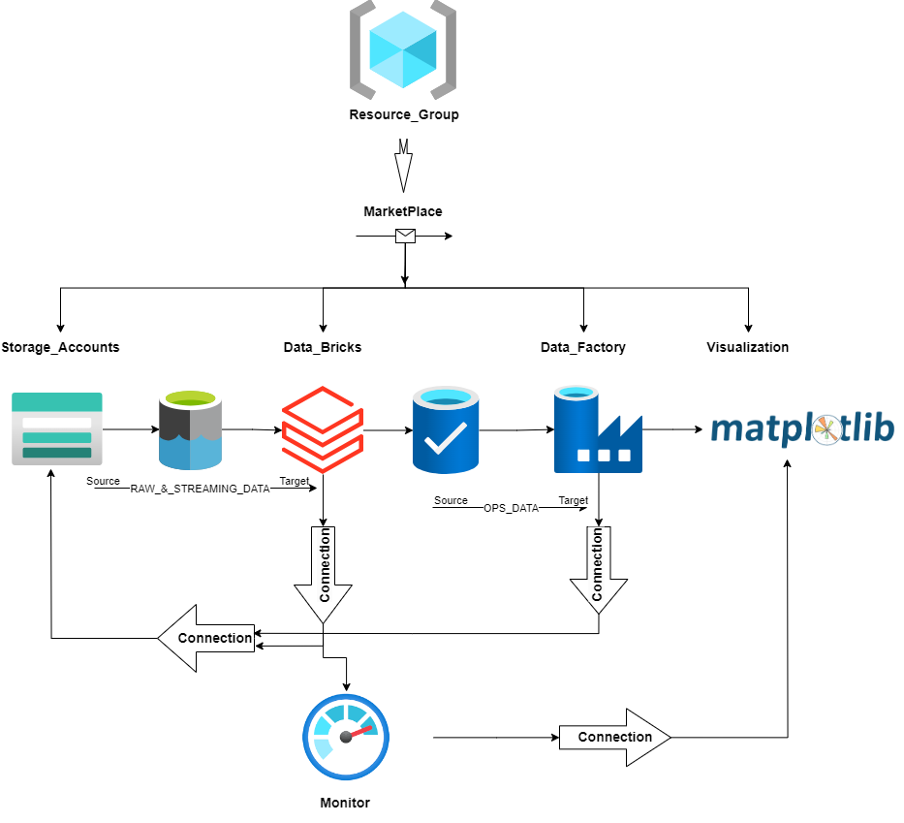
Architecture

Slide 7
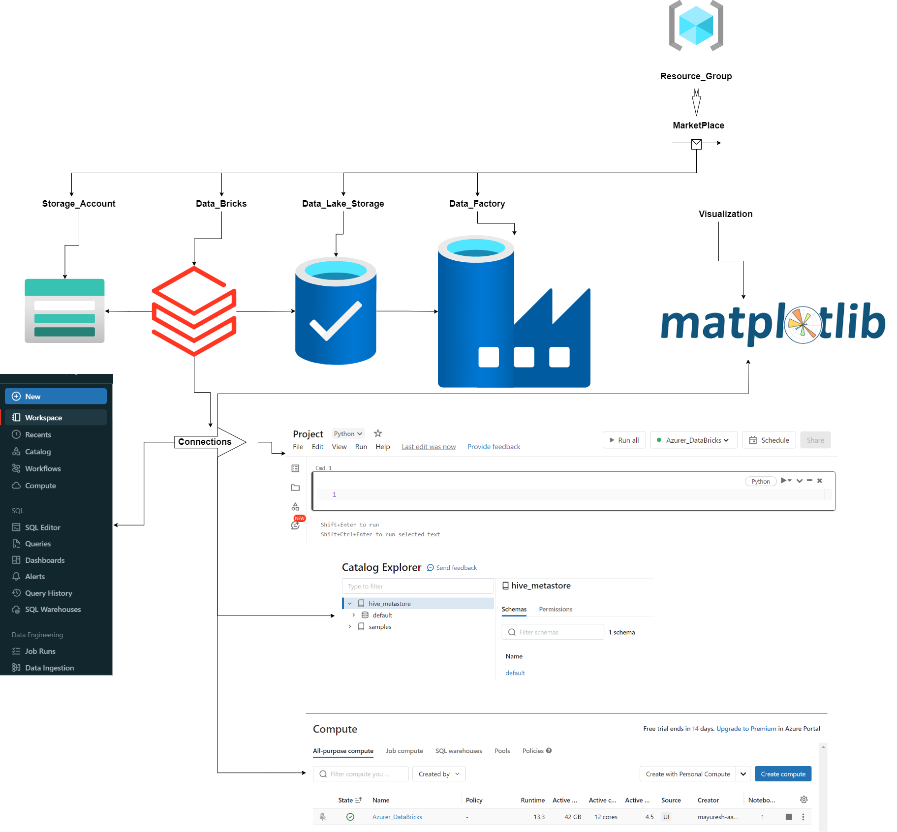
Flow Diagram
Azure Data Bricks

Slide 8
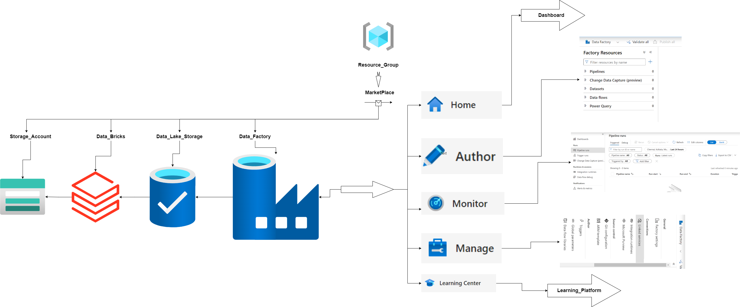
Azure Data Factory

Slide 9
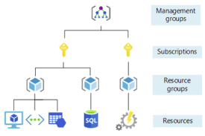
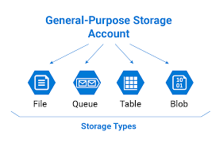
Azure Platform
Azure Resource Group :-
Azure Resource Group Is The One Which Contains All The Resources Required For The Project. Creating Azure Resource Group :-
Azure Storage Account :-
Azure Storage Account Contains All Of The Azure Storage Data Objects Such As: Blobs, Files And Tables. Creating Azure Storage Account :-

Slide 10


Azure Data Factory :- Big Data Requires A Service That Can “Orchestrate” And Operationalize Processes To Refine The Enormous Store Of Raw Data Into Business Insights. Azure Data Factory Is Managed Cloud Service That Is Build For The Complex Hybrid ETL And Data Integration Project . Here Is How We Create Azure Data Factory.
Azure Databricks :- Azure Databricks Provides Us The Platform Which Allows Us To Seamlessly Integrate With Open Sources Libraries. Creating Azure Databricks

Slide 11
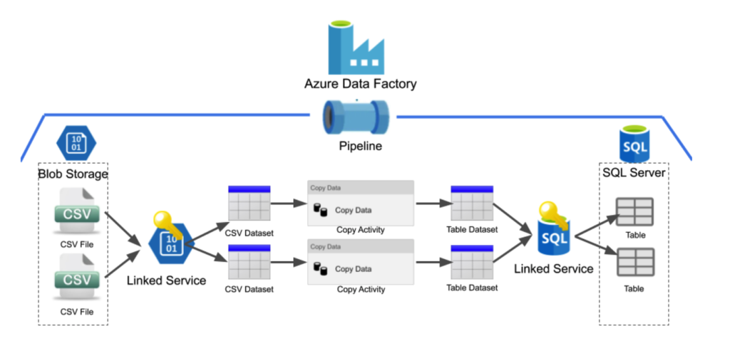
Data Integration
DATA INTEGRATION :-
This refers to the process of combining data from multiple sources across an organization ton provide a complete, accurate, and up to date dataset for analysis
DATA INTEGRATION IN AZURE DATA FACTORY :-
It is a process of creating and scheduling data-driven workflows that can ingest, process, and publish data from various service

Slide 12
Queries
Identify the factors for flight delays.
Calculated average delay.
Calculated what are the busiest airports.
Calculated what are the busiest airlines.
Calculated total number of flight delays and cancellations.
Identified that Weather changes and security delays are the reasons for cancellations

Slide 13
Operations
CLEANSING:-
In cleansing we handled the missing values, duplicate values, replaced null values with zeros
na.drop
Dataframe.dropDuplicates
TRANSFORMATIONS :-
In the transformations we did operations like filtering, joining, groupby, orderby, aggregation functions
filter
Join
Sum
Average
Max
Min
Count

Slide 14
Batch Processing
There are two files we are using for the batch processing they were airports and airlines datasets in csv file format, also we performed various operations like cleansing and transformations on batch processing
For more information regarding batch processing just go through the below link:
For Practical Sessions :-
Batch Processing

Slide 15
Streaming Processing
The process what we done for the batch processing that can be done same for the streaming part also like data cleansing and data transformations and along with visualization with the given datasets like flights_latest.csv and flights_sample.csv
Lets just deep dive in to the streaming part of the project with the provided link below:
For Practical Sessions :-
Streaming Processing

Slide 16
Visualization
Data visualization is the practice of translating information into visual context, such as map or graph, to make data easier
For the human brain to understand.
For our project we have used Matplotlib and seaborn.
These are the library used for making statical graphics in python.
For Practical Sessions :-
Visualization

Slide 17

Conclusion
In Conclusion, We Have Accepted A Task To Analyze The Performance Of Domestic Flights Operated By Major Air Carriers Within The United States. For That, We Have Made Use Of Different Technologies Like Pyspark, Azure Data Lake Storage, And Azure Data Factory. We Have Created An Efficient Data Processing Pipeline Between All The Required Technologies. We Have Cleaned The Data And Handled All The Missing Values. We Have Done Some Operations On The Data And Made Different Graphs And Pie Charts For A Better Understanding Of The Data.

Slide 18
Thank You
Team Krishna

